Slide 1
Resourced provision (RP) network for autism spectrum (AS)
12 March 2025
Di Lowth

Slide 2
Welcome and Agenda
Annual return
RP guidance
Training opportunities
AOB

Slide 3
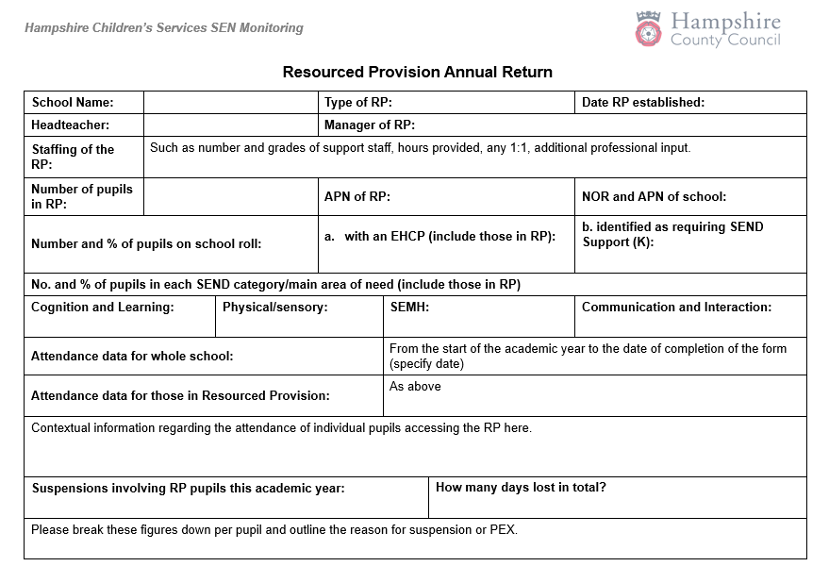
Sample annual return Please email this return to: Ebi.Erhahiemen2@hants.gov.uk by 31st July

Slide 4
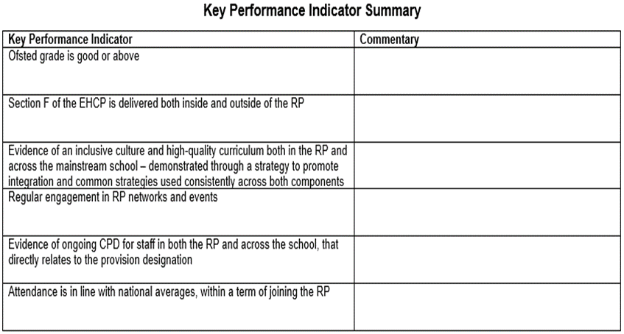

Slide 5
Annual return
We can celebrate the good practice.
Data is collected on a school level and therefore doesn't tell the whole story of the RP, so the annual report is an opportunity to share successes and equally any challenges you would like us to know about

Slide 6
Excerpt from email to headteachers
Annual Return
In order to maintain ongoing dialogue with our RP, an annual return will be requested at the end of each academic year. It will provide headteachers and RP leaders an opportunity to share successes against the KPI as well as an opportunity to make any requests regarding training or support known to the LA.

Slide 7
Resourced provisions (RP) distribution

Slide 8
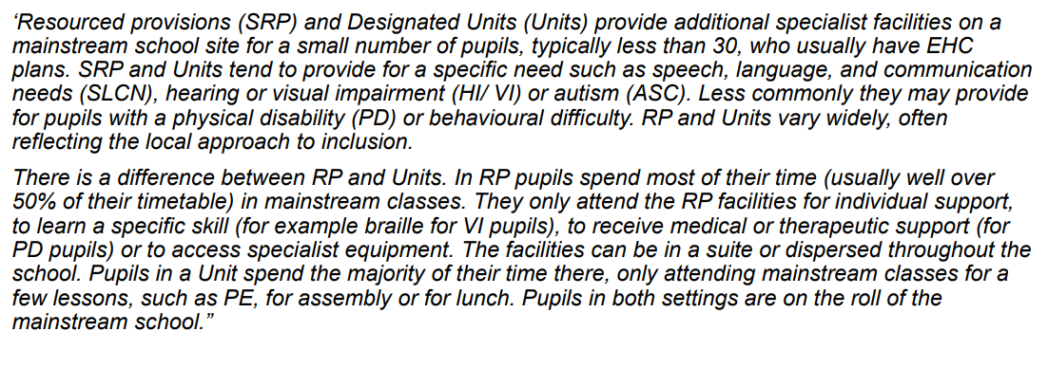
RP – Department for Education (DfE) guidance

Slide 9
Sufficiency strategy 3 new and 23 in progress
Hampshire RPs expected key performance indicators (KPI)
Ofsted grade is good or above.
Section F of the EHC plan is delivered both inside and outside of the RP.
Evidence of an inclusive culture and high-quality curriculum both in the RP and across the mainstream school, demonstrated through a strategy to promote integration and common strategies used consistently across both components.
Quality assurance visits demonstrate an inclusive culture and high-quality curriculum for children both in the RP and across the mainstream setting.
Regular engagement in RP networks and events.
Evidence of ongoing CPD for staff in both the RP and across the school, that directly relates to the provision designation.
Attendance is in line with national averages, within a term of joining the RP.
Reasonable adjustments are in place to ensure the behaviour policy meets the needs of children supported by the RP.
Evidence of increasing time spent reintegrating into the mainstream part of the school.
Quality assurance (QA) processes
Initial visit within 6 months of opening
Follow up visit between12 to 18 month (as required)
QA monitoring visit on 3-year cycle with self evaluation
Annual return

Slide 10
AS RP –The vision
RP pupils are part of the whole school – they are part of a mainstream class and have an identity in this class.
RP pupils progress is measured in exactly the same way as every other pupil and the class teacher is accountable for the progress of every child in their class…
RP pupils progress is also reviewed as a distinct group. This data is compared to that of the rest of the school, and this will then include measures against EHC plan targets and interventions to inform next steps/interventions… (attendance, behaviour incidents, suspensions)
Each RP pupil will have a provision map so that VFM can evaluated
Pupil voice will be gathered regularly and used to inform provision and plans
Parent voice will be gathered regularly and used to inform provision and plans
RP will have an action plan that links with the SEN action plan that is then reflected in the whole school development plan
Whole school processes/policies will be reviewed to ensure that they are inclusive
Systems are in place to support staff well being – i.e. supervision
Staff training accounts for RP designation
Comprehensive list of appropriate outside agencies (MHST, PBS…)
RP staff member DSL
RP numbers are in addition to PAN as the APN for the RP is separate from the mainstream

Slide 11
However,…..
Doing the right thing for the young person is paramount and we know that AS needs may mean a gradual approach/exposure to achieve the positive outcomes in the future

Slide 12
Resourced provision Toolkit

Slide 13
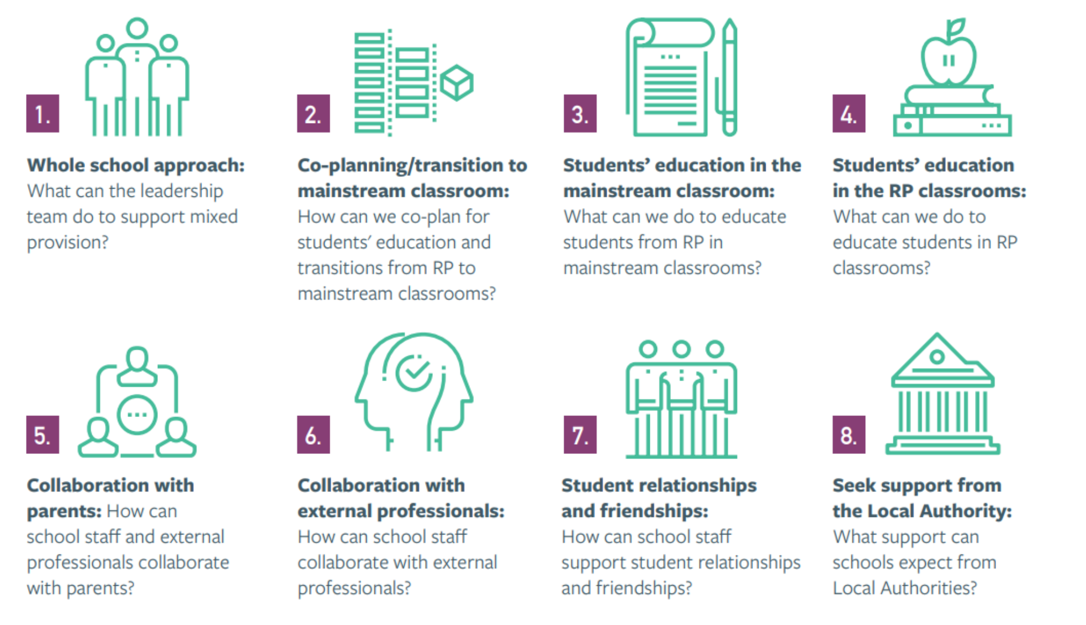

Slide 14
Maintained Special schools
24 special schools across the County
All through are MLD/SLD/PMLD
4 have AS as part of their designation
5 SEMH, 2 Primary and 3 Secondary
Primary | Secondary | All through
8 | 8 | 8

Slide 15
Sources of support (Outreach):
Primary | Secondary | All through
Heathfield | Baycroft | Henry Tyndale
Maple Ridge | Osborne | Hollywater
Norman Gate | Education centres: Ashwood, The Key, Greenwood, Rowhill, Smannell Field, The Bridge | Oak Lodge
Riverside
Shepherd’s Down
PBS

Slide 16
Louisa.Gray@hants.gov.uk

Slide 17
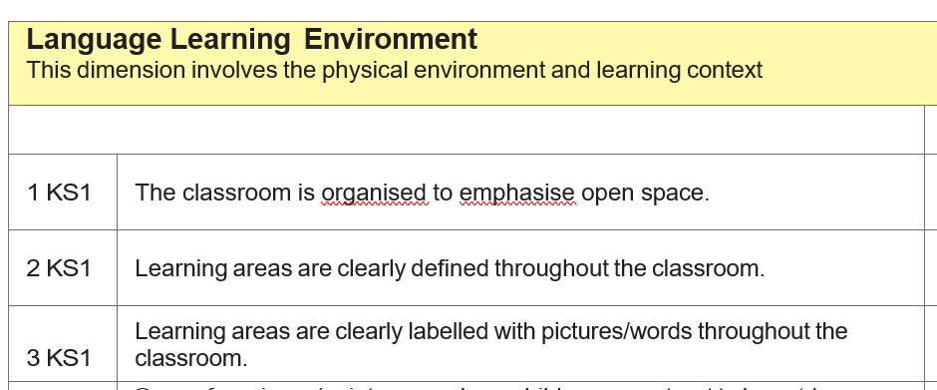
Inclusive Audits
Sensory Environment
Communication Friendly Classroom
Notes:
½ day visit
Discussion with the school about their provision in general
Assessment of the site focussed on either the sensory environment or an observation of the communication-friendly practice taking place
Report – strengths and recommended actions
The report is advisory, so it is up to the school to tackle what they can achieve or afford.​

Slide 18
Feedback
It was a great opportunity to seek advice that we can then share with staff to make them reflect on their classrooms and the impact they have on children and adults. From a management point of view the report assists action planning regarding the school environment and further development of it.
We have spaces which are less overwhelming for the pupils to use and this has been beneficial to them in supporting them with their regulation.
It was great to look at school through a different lens. It was surprising what we no longer see as we are in school all the time.
Notes:
No feedback yet on CFC as we give them some time to implement the actions

Slide 19
Follow Up Training Sessions
The Sensory and Physical Environment and Toolbox of Strategies
The Communication Friendly Classroom and Communication Strategies Across the Curriculum
Additional topics include:
Neurodiversity
The Social Code
Transition (various ages)
Notes:
School based training sessions are being delivered by STAS as either whole INSET days or broken down into twilights.
The focus of these sessions is whole school and class-based inclusion.
If schools have the audit beforehand then specific aspects can be addressed via the training to ensure that all staff understand the rationale and steps that need to be taken to address the highlighted areas.

Slide 20
Sensory Environment Training Feedback
Decluttering: Remove unnecessary items and visual clutter to make the classroom less busy.
Simplifying Displays: Pair back what is displayed and the colours used around the school.
Clear Labelling: Use clear and appropriate language and images for classroom labelling.
Reducing Stimuli: Take down some materials to minimize distractions.
Movement and Breathing Breaks: Incorporate movement breaks and breathing techniques more often.
Personalized Sensory Breaks: Base sensory breaks on individual children's needs rather than a fixed plan.
Awareness: Be more aware of the environment and its impact on students.

Slide 21
Communication Friendly Classroom Training Feedback
Levels of Questioning: Use different levels of questioning and plan them before the topic.
Questioning Skills: Develop skills to ask a range of questions and introduce topic words as a class.
Visual Aids: Incorporate more visuals and symbols in the classroom.
Response Time: Give children ample time to respond to questions and allow more thinking time.
Check-ins: Regularly check in with children to talk and engage in social conversations.
Word Maps: Use word maps to support learning.
Help Cards: Implement red/green help cards on tables for assistance.
Emotional Traffic Lights: Use traffic lights to help children express their emotions.
Communication Zones: Create designated communication areas in the classroom.

Slide 22
Speech and language therapy
Currently we are delivering training requested by schools where they have requested a specific theme. If there was a training session an RP or group of RPs or the RP network would like training on, then I am happy for them to contact me to enquire and build a bespoke session. Our training rates are costed at £300 an hour. These can be virtual or in person.
Elklan
We have Elklan tutors in our team. If there were a group of RP staff that were interested in attending an Elklan course then we could explore this as an option.
There are courses for:
supporting autistic learners
supporting SEMH of children and young people
Speech and language support for 5 to11 year olds
Speech and language support for 11 to16s year olds.
If any RPs or a group of RPs would like to know more – the courses that are available are on here Training for Practitioners | Elklan Training Ltd and we have Elklan tutors in the team and could look to set up a course for you.

Slide 23
Other sources…
Hampshire Outdoor Education
https://www.hants.gov.uk/educationandlearning/participation-lifelong-learning/trailblazer
https://www.henrytyndale.hants.sch.uk/training/autism-education-trust/
From Autism Hampshire – CAMHS
Our information should be given to families whilst they are waiting, we cover all of the CAMHS services however from this year not the Frimley area (Aldershot CAMHS). We offer advice pre and post diagnosis via phone, email, face to face or via teams appointments. Families can also access our CAMHS family workshops whilst they are waiting or after a diagnosis is made. When a diagnosis is made CAMHS will arrange a MAP (multi agency planning session) with the family, school, Autism Hampshire and the CAMHS clinician to come up with a plan of how the family can be supported after CAMHS discharge. We will then introduce our service and take the details of the family so we can contact and offer a post diagnosis appointment to discuss more in depth any difficulties they are having. The family can then access our service as and when needed throughout their child’s life as we also support adults. IAG is not an open and close service people can come and go as they need to.
Does anyone have any further free training offers they utilise? If so – can you put it in the chat

Slide 25
Aims of the physical education (PE) SEND inclusion project
Empower teachers with the right tools, understanding and resources to deliver a truly inclusive physical education curriculum.
Provide access to introductory resources and training that develop teachers’ skills and confidence to deliver truly inclusive physical education.
Redefine how physical education is seen within the school curriculum, ensuring it becomes a priority for all children.
Online workshop (Spring/Summer 2025)
Curriculum Principles
Curriculum Principles Framework
Glossary
Example learning activities/units to exemplify principles into practice (to follow summer term 2025)

Slide 26
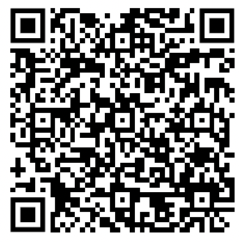
Workshop/ webinar dates
Join us, in person, on either
24 March 2025, from 1.30pm to 3pm
or
2 April 2025, from 1.30pm to 3pm
at Elizabeth II Court, Winchester, SO23 8BH
If you cannot attend, please can you complete the form, and we will be in touch with alternative dates and times.
https://shorturl.at/cWUd9

Slide 27
SEN Support Toolkit, SEN Support Line & SEN Advisers
A SEN Support Toolkit, offering online resources and signposting to advice, guidance and best practice information in supporting pupils with SEN needs. The focus is on the graduated approach which underpins practice for all children with SEN and as such this toolkit may be useful for all colleagues supporting children with SEN needs.
Access to the online SEN Support Toolkit is free and unhindered by paywalls or passwords. Simply select the link to access
Course: Hampshire SEN Support Toolkit
A SEN Support Line, offering tailored email or telephone / Teams' responses from highly qualified SEN professionals about specific challenges or concerns practitioners in school may still need support with after liaison with colleagues including their SENCo, and having accessed the SEN Support toolkit.
Please save the SEN Support Line enquiry form link to your favourites. If you don’t want to use them immediately it will help make it easy to find them when you do want them! https://forms.office.com/e/mrX19kBP82
Three new SEN Advisers, who will operator our new SEN Support phone line and manage our new SEN Support Toolkit.
They can be commissioned by school to support teachers in the classroom, using the 'plan, do, review' approach to better meet the needs of children and young people in the classroom(s).
The SEN Advisers can also be commissioned to provide support, guidance and problem solving with teachers and SENCo's on classroom-based support.
They join our already established team of special educational needs inspectors and are all available to support our schools.
senadvisorbooking@hants.gov.uk

Slide 28
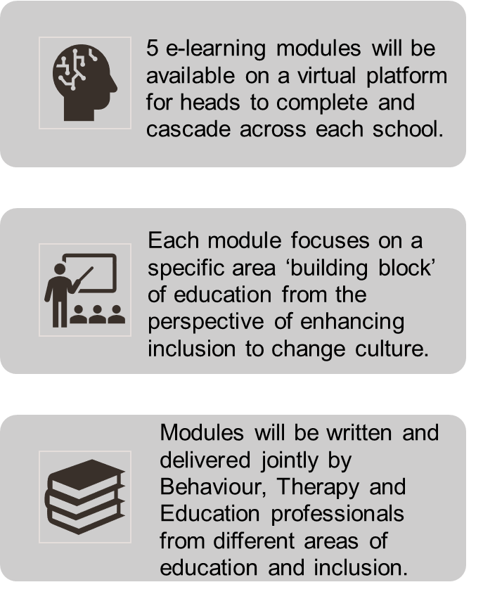
A reminder, 5 training Modules
Module 1
Neurodevelopmental approaches to learning
Module 3
Inclusive curriculums and the four pillars of an inclusive curriculum
Module 5
Relationships, behaviour and attendance, taking a neurodiversity affirming approach
Module 2
Module 4
Inclusive teaching and strategies that will extend and support
Inclusive learning environments
SEN Moodle: All courses (hants.gov.uk)
Centrally Funded

Slide 29
AOB and next meeting
Anyone had a recent Ofsted experience? Highlights?
Forest School; who has set one up recently and how was the experience?
Prospect School has a forest skills provision which they are happy for anyone to visit.
And – we are going on the road! – next meeting will be on 17 June at Horndean Technology College, Waterloo PO8 9PQ

