Slide 1
Resourced provision (RP) network for moderate learning difficulties (MLD)/ severe learning difficulties (SLD)
10 March 2025
Marie Mullins

Slide 2
Welcome and Agenda
Welcome and agenda
RP Toolkit
Solihull for parents
Sharing Professional Expertise – Jodie Boscombe
E modules, phone line and resources
Exploring Heathfield School

Slide 3
Resourced provision Toolkit
Working together to look at a section of the toolkit.
We are looking at the section on: Area 2 Co-planning and transition to mainstream classroom

Slide 4
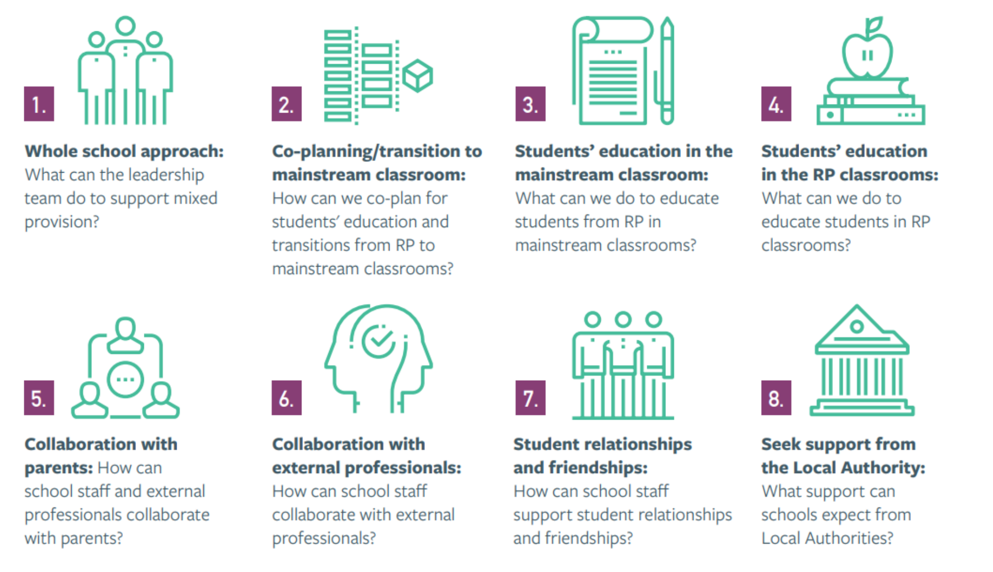

Slide 5
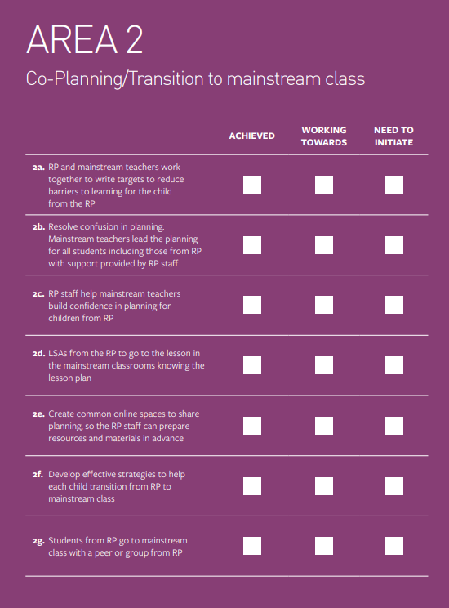

Slide 6
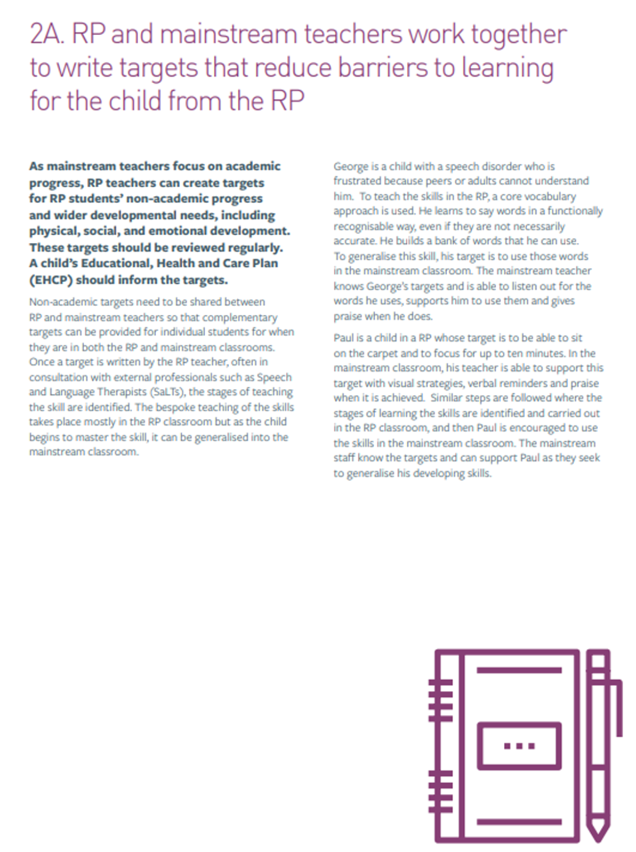
RP and mainstream teachers work together to write targets that reduce barriers to learning for the child from the RP
Nonacademic targets need to be shared.
Bespoke teaching of skills needs to be taught in the RP and then generailsed and transferred to mainstream classroom.
Communication is key and a common language used.
Clear targets and strategies shared.
Everyone has an opportunity to share the progress made and any tips, wins and key messages are communicated.

Slide 7
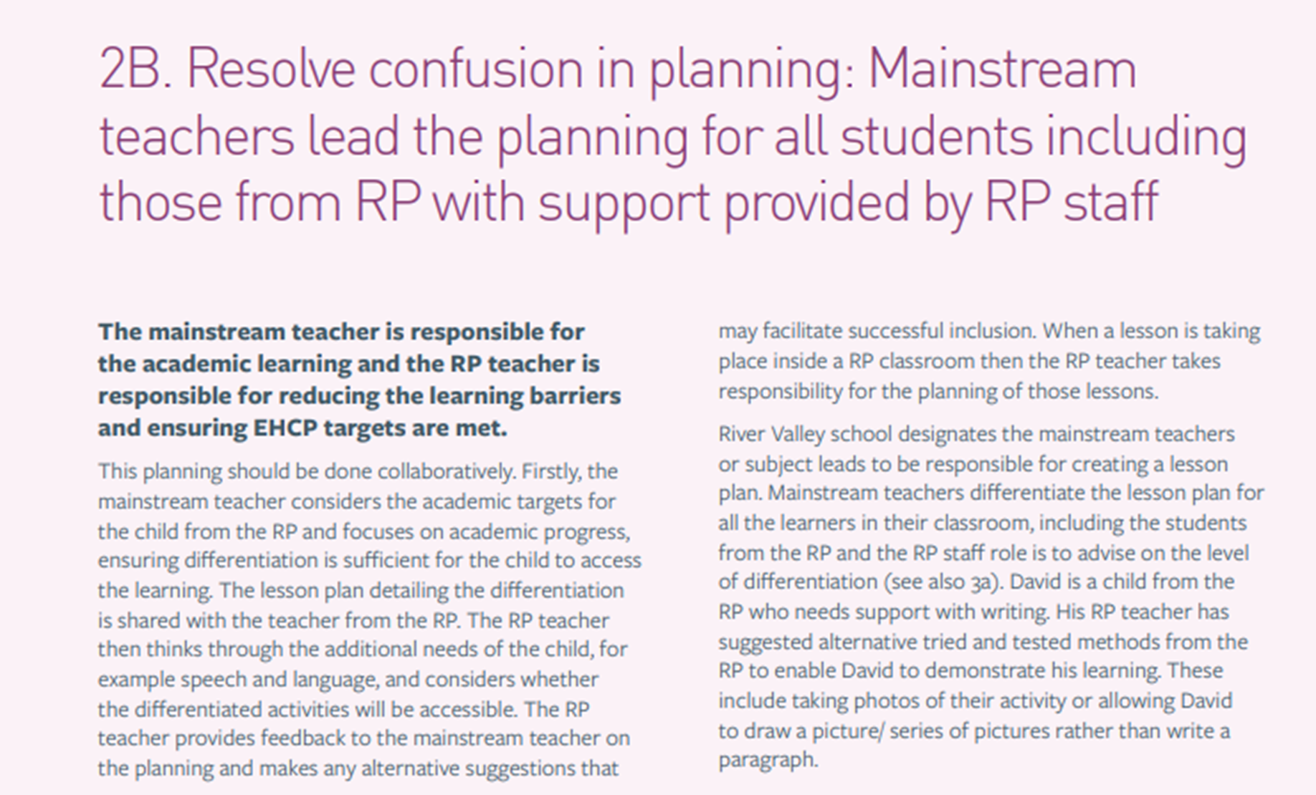
Resolve confusion in planning
Planning should be collaborative.
Feedback is essential to ensure a successful inclusion.
Lesson plans are shared, and the RP manager considers whether adapted activities will be accessible.

Slide 8
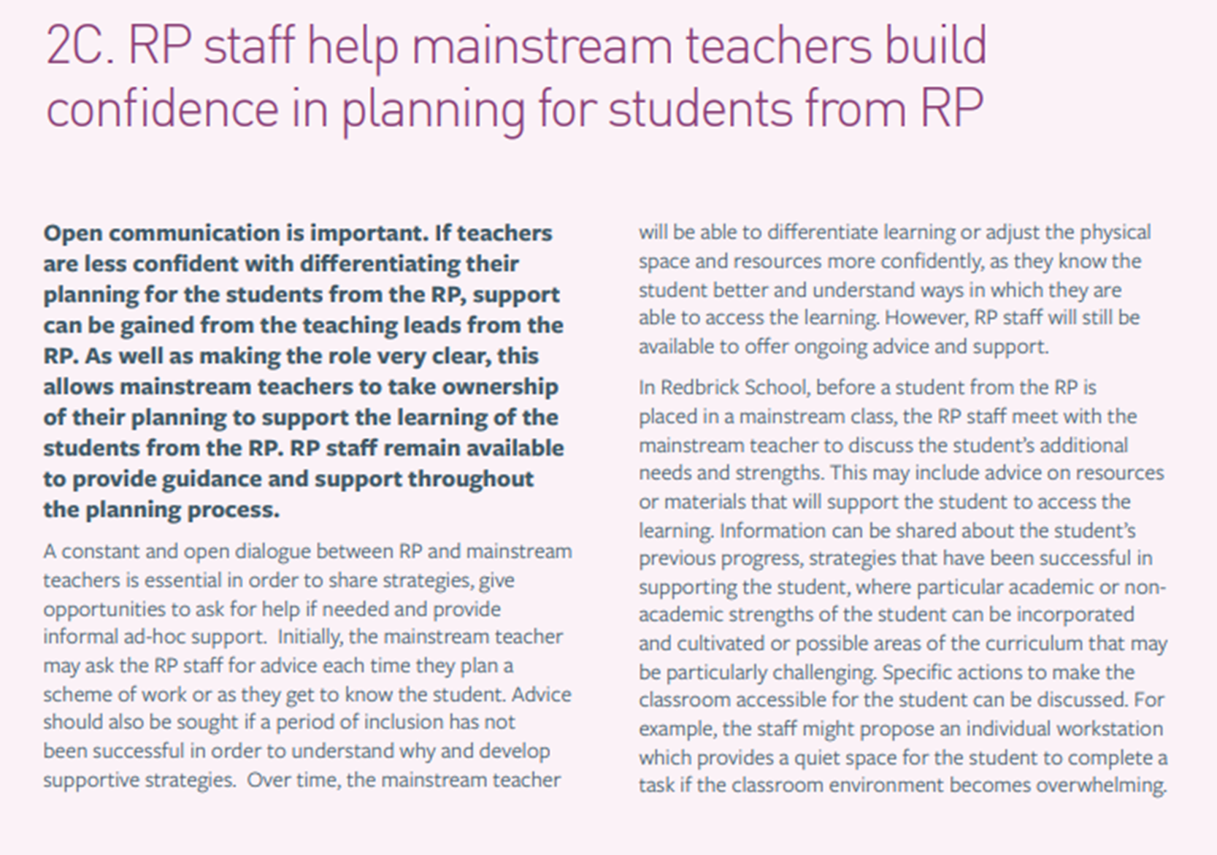
Confidence in planning
Open dialogue is key sharing strategies and provide opportunities for support.
Mainstream teachers take ownership of their planning, but RP staff are on hand to support.
Ensure advice and resources is given. RP team to share the pupils' strengths and needs so that relational approach can be developed focusing on their strengths.

Slide 9
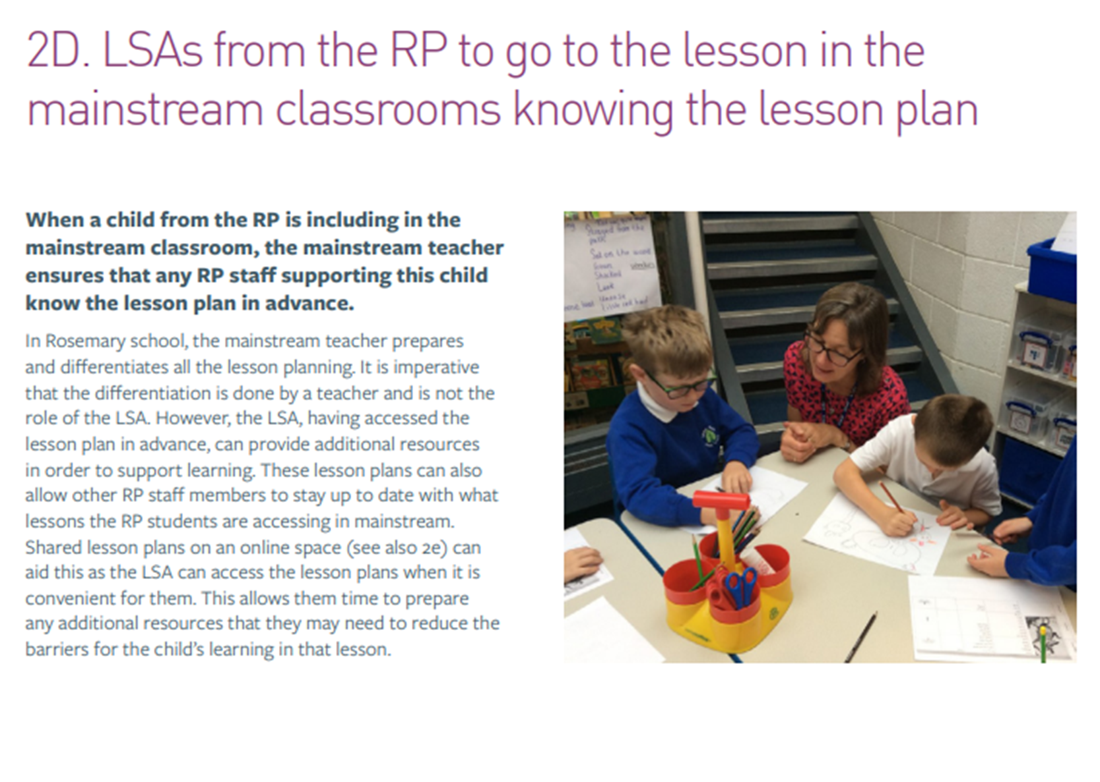
Learning support assistants (LSA) from the RP attend lessons in the mainstream class knowing the lesson plan
LSA’s have access to the lesson plan in advance.
LSA’s can provide additional resources and suggest any changes that may support the pupil.
LSA can support any barriers to learning and help to develop task to make them more engaging to the pupil.

Slide 10
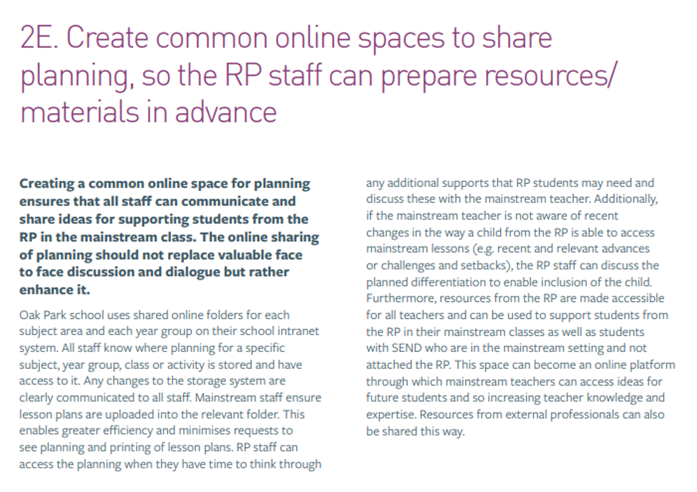
Create a common online space to share planning, so that resources can be prepared in advance
Staff have access to lessons online in a shared document.
Changes are clearly communicated.
Resources in the RP are made available to all so that they can be used to support RP students and students with special educational needs and disabilities (SEND).

Slide 11
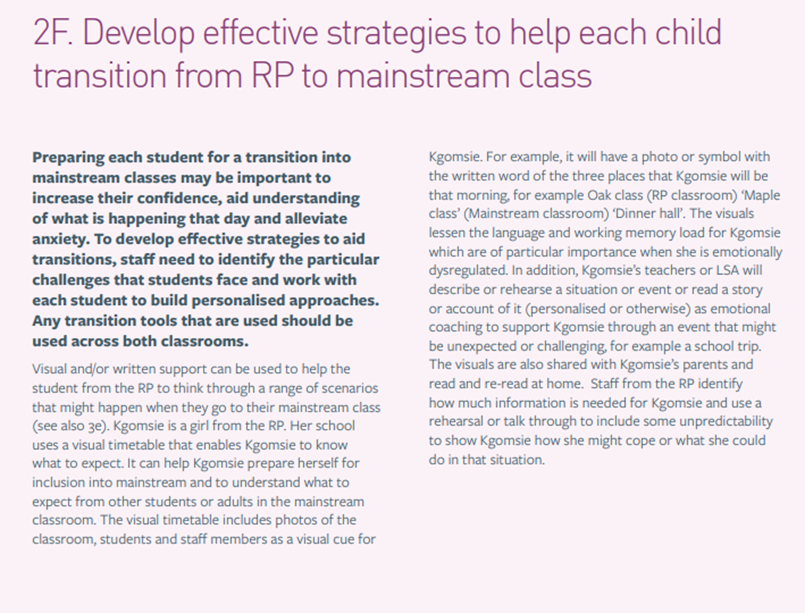
Develop effective strategies to help child transition from RP to mainstream class
Visual or written support can be used, and a timetable is key.
Visuals lessen the memory overload, and a social story can help prepare them for the transition.
A script with common language in or key phrases that support and calm a pupil can help in the same way a social story does.

Slide 12
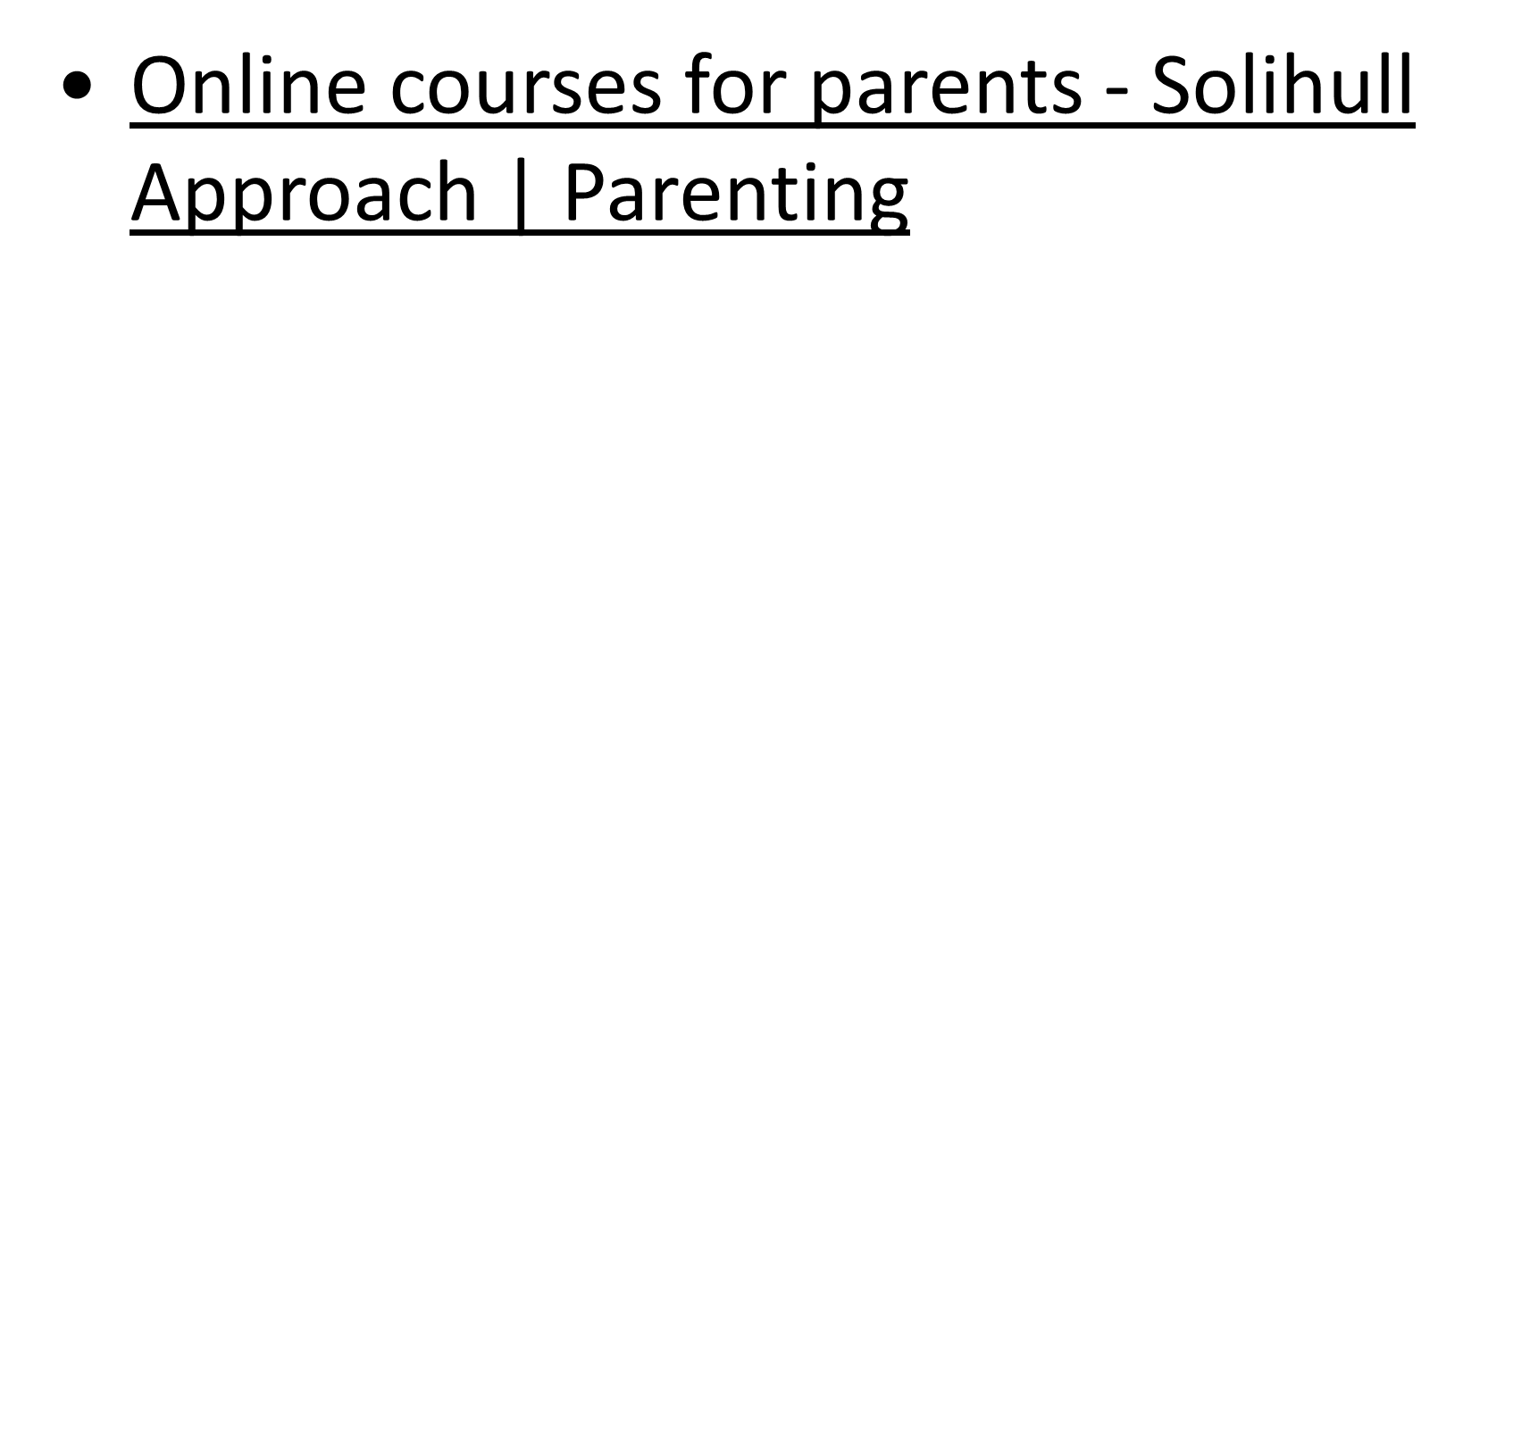
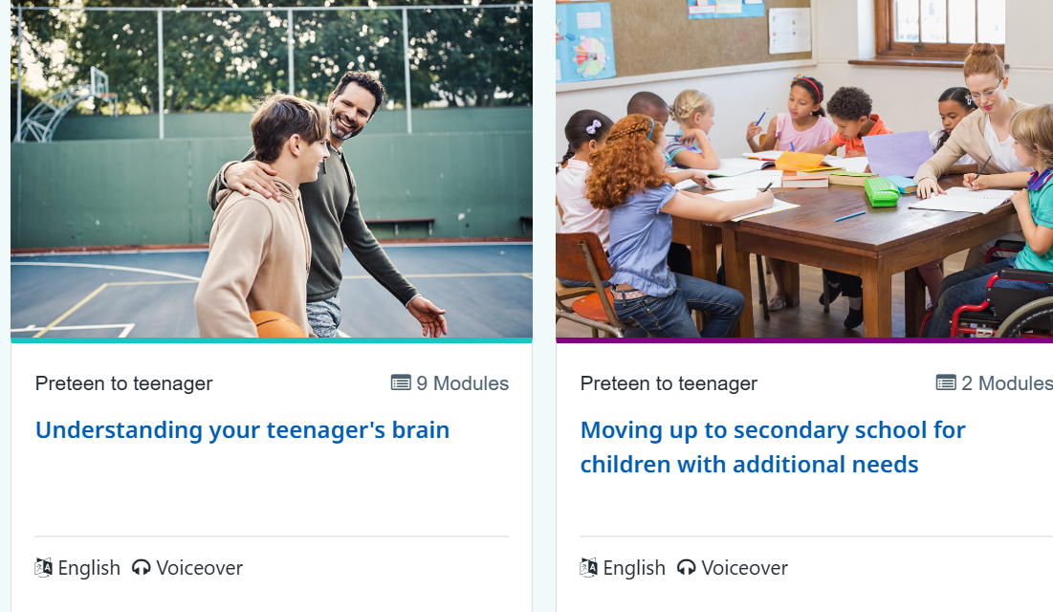
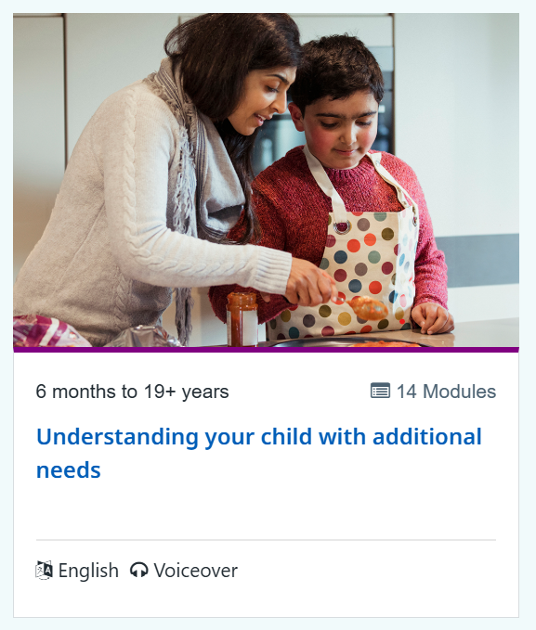
Solihull training free for parents and staff

Slide 13
Parent advice line

Slide 14
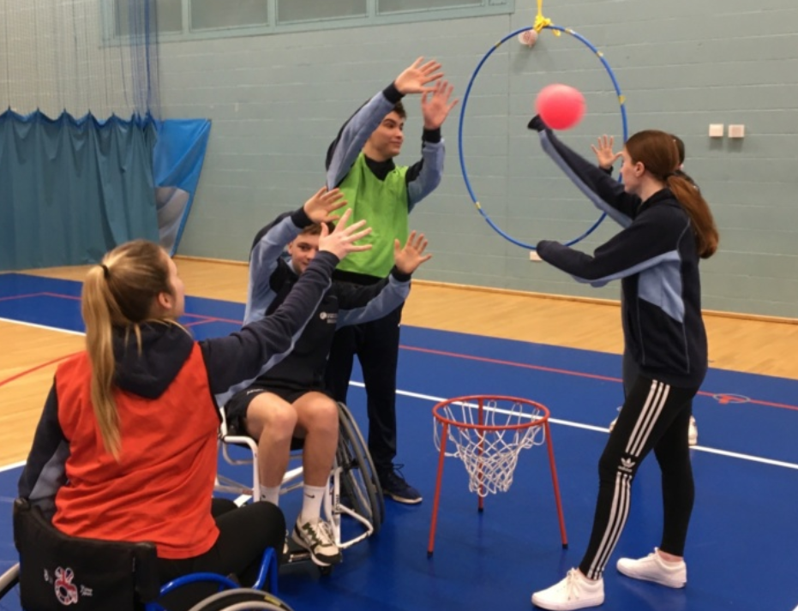
Sharing professional expertise Floor books by Jodie Boscombe and Vicky Randall

Slide 16
Why does it matter?
75%
1 in 3
15%
Of disabled children are not taking part in physical activity/sport in school (Activity Alliance, 2020)
Disabled children take part in less than 30 minutes of sport and physical activity per day during term time.
Of the school populations is disabled.
We know that a positive experience in PE and school sport is essential to shape every child’s life-long participation in physical activity.
This is in comparison to 21% of non-disabled children
Teachers explain ‘they struggle to deliver inclusive PE without the training, funding and the confidence to do so.

Slide 17
Aims of the physical education (PE) SEND inclusion project
Empower teachers with the right tools, understanding and resources to deliver a truly inclusive physical education curriculum.
Provide access to introductory resources and training that develop teachers’ skills and confidence to deliver truly inclusive physical education.
Redefine how physical education is seen within the school curriculum, ensuring it becomes a priority for all children.
Online workshop (Spring/Summer 2025)
Curriculum Principles
Curriculum Principles Framework
Glossary
Example learning activities/units to exemplify principles into practice (to follow summer term 2025)

Slide 18
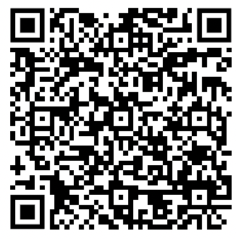
Workshop/ webinar dates
Join us, in person, on either
24 March 2025, from 1.30pm to 3pm
or
2 April 2025, from 1.30pm to 3pm
at Elizabeth II Court, Winchester, SO23 8BH
If you cannot attend, please can you complete the form, and we will be in touch with alternative dates and times.
https://shorturl.at/cWUd9

Slide 19
Annual return
We can celebrate the good practice.
Data is collected on a school level and therefore doesn't tell the whole story of the RP, so the annual report is an opportunity to share successes and equally any challenges you would like us to know about

Slide 20
Key performance indicators (KPI) and annual return
Hampshire RPs expected KPIs
Ofsted grade is good or above.
Section F of the EHC plan is delivered both inside and outside of the RP.
Evidence of an inclusive culture and high-quality curriculum both in the RP and across the mainstream school, demonstrated through a strategy to promote integration and common strategies used consistently across both components.
Quality assurance visits demonstrate an inclusive culture and high-quality curriculum for children both in the RP and across the mainstream setting.
Regular engagement in RP networks and events.
Evidence of ongoing CPD for staff in both the RP and across the school, that directly relates to the provision designation.
Attendance is in line with national averages, within a term of joining the RP.
Reasonable adjustments are in place to ensure the behaviour policy meets the needs of children supported by the RP.
Evidence of increasing time spent reintegrating into the mainstream part of the school.

Slide 21
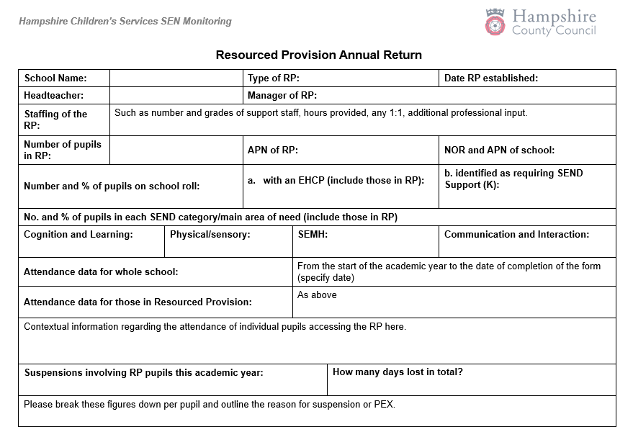
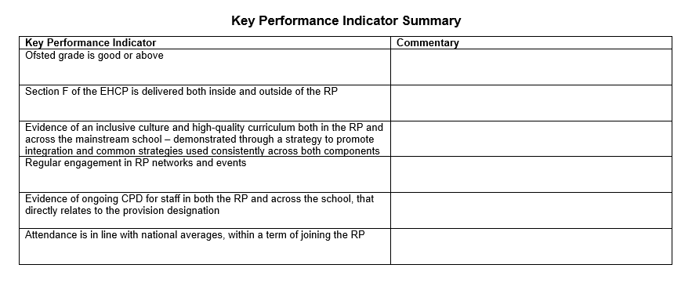
Sample annual return

Slide 23
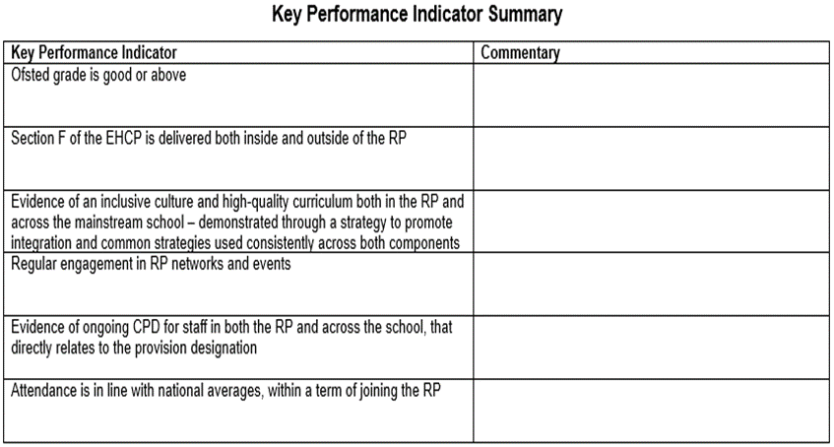

Slide 24
Excerpt from email to headteachers
Annual Return
In order to maintain ongoing dialogue with our RP, an annual return will be requested at the end of each academic year. It will provide headteachers and RP leaders an opportunity to share successes against the KPI as well as an opportunity to make any requests regarding training or support known to the LA.

Slide 25
Updates and free training
Free online sensory processing course for teachers, assistants and parents
Free Online Special Needs Course with Certificate

Slide 26
Ofsted updates
Search - GOV.UK (www.gov.uk) a one stop shop page for all Ofsted updates and Ofstednews – YouTube for videos and webinars.

Slide 27
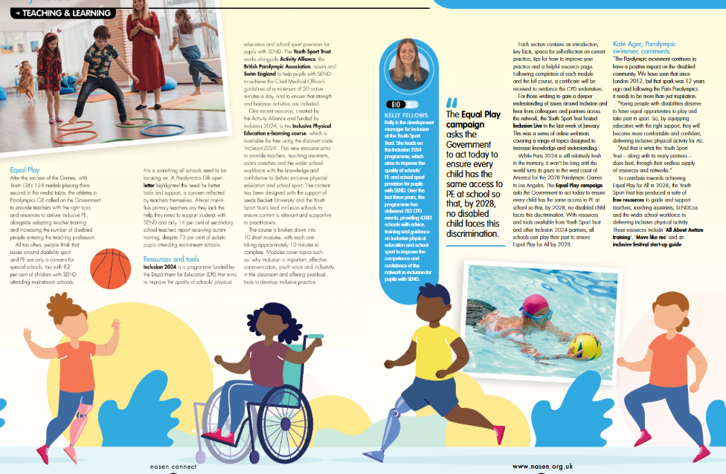
NASEN Resources
nasen Connect magazine Spring Term edition 2025 | Nasen

Slide 29
Online CPD Units | Whole School SEND

Slide 30
SEN Support Toolkit, SEN Support Line & SEN Advisers
A SEN Support Toolkit, offering online resources and signposting to advice, guidance and best practice information in supporting pupils with SEN needs. The focus is on the graduated approach which underpins practice for all children with SEN and as such this toolkit may be useful for all colleagues supporting children with SEN needs.
Access to the online SEN Support Toolkit is free and unhindered by paywalls or passwords. Simply select the link to access
Course: Hampshire SEN Support Toolkit
A SEN Support Line, offering tailored email or telephone / Teams' responses from highly qualified SEN professionals about specific challenges or concerns practitioners in school may still need support with after liaison with colleagues including their SENCo, and having accessed the SEN Support toolkit.
Please save the SEN Support Line enquiry form link to your favourites. If you don’t want to use them immediately it will help make it easy to find them when you do want them! https://forms.office.com/e/mrX19kBP82
Three new SEN Advisers, who will operator our new SEN Support phone line and manage our new SEN Support Toolkit.
They can be commissioned by school to support teachers in the classroom, using the 'plan, do, review' approach to better meet the needs of children and young people in the classroom(s).
The SEN Advisers can also be commissioned to provide support, guidance and problem solving with teachers and SENCo's on classroom-based support.
They join our already established team of Special Educational Needs Inspectors and are all available to support our schools.

Slide 31
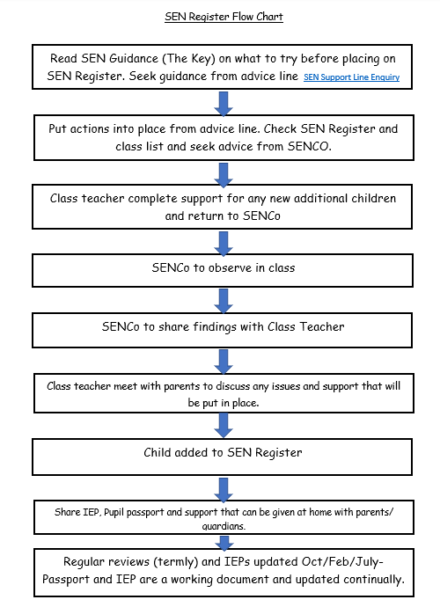
SEN Flow chart

Slide 32
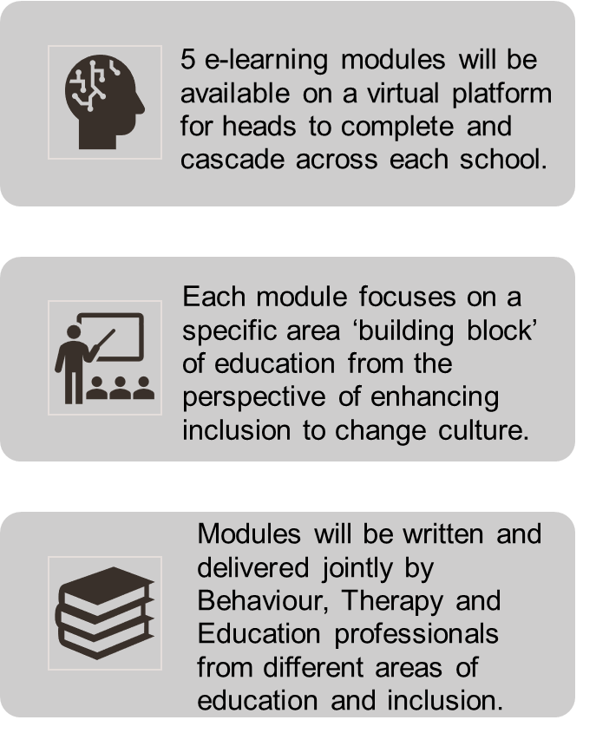
A reminder, 5 training Modules
Module 1
Neurodevelopmental approaches to learning
Module 3
Inclusive curriculums and the four pillars of an inclusive curriculum
Module 5
Relationships, behaviour and attendance, taking a neurodiversity affirming approach
Module 2
Module 4
Inclusive teaching and strategies that will extend and support
Inclusive learning environments
SEN Moodle: All courses (hants.gov.uk)
Centrally Funded

Slide 33
Next network meetings
24 June 2025 from 4pm to 5.30pm
Chaired by Marie Mullins

