Slide 1
Resourced provision (RP) network for moderate learning difficulties (MLD)/ severe learning difficulties (SLD)
18 November 2024
Marie Mullins

Slide 2
Welcome and Agenda
Welcome and agenda
RP Toolkit
Child and adolescent mental health services (CAMHS) resources for parents
Sharing Professional Expertise – Gemma Waldron
E modules, phone line and resources
Future RP meetings – What you want, what you need and where?

Slide 3
Resourced provision Toolkit
Working together to look at a section of the toolkit.
We are looking at the section on: Area 1 – Whole School Approach

Slide 4
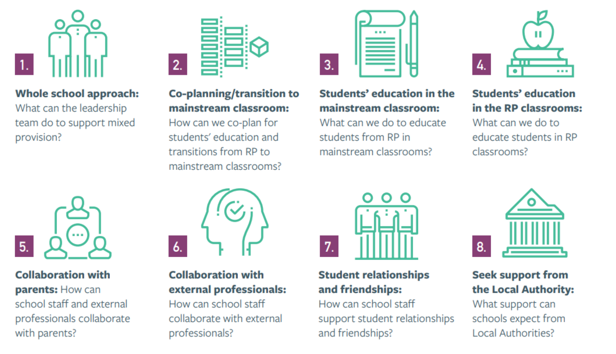

Slide 5
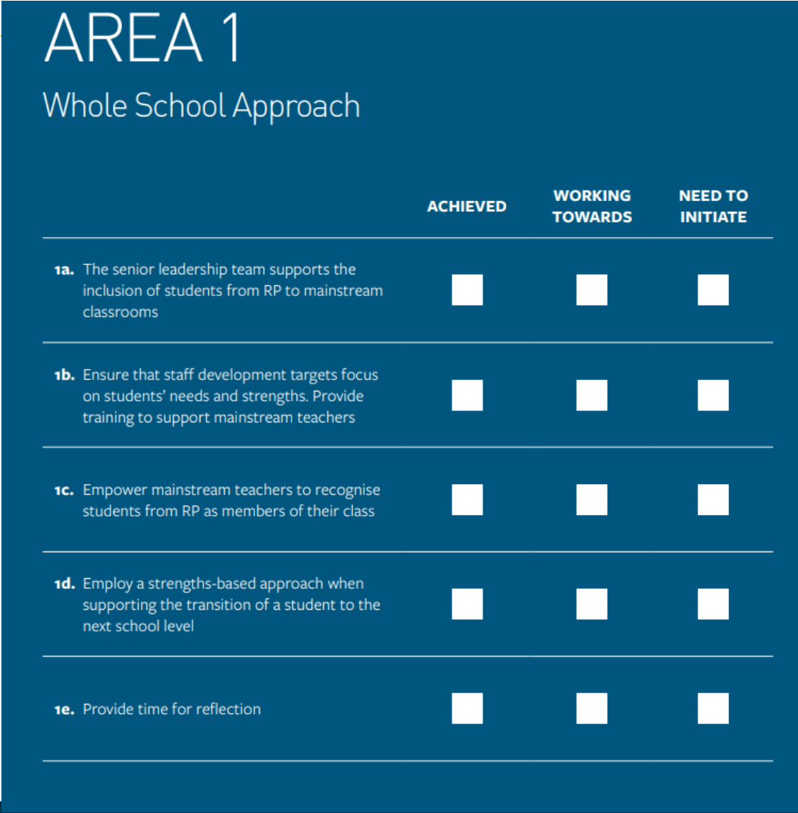

Slide 6
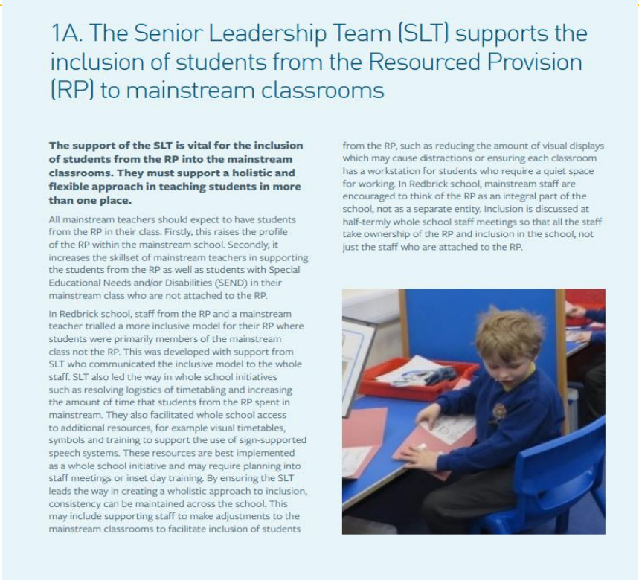
Senior leadership team (SLT) support a holistic and flexible approach in teaching students in more than one place
Skill set of mainstream staff raised.
Inclusive environments for all.
SLT buy in and lead the way in initiatives.
Visuals are clear, common language in setting shared and areas are less busy.
RP is an integral part of the school.
Everyone has ownership and it is part of the staff meeting agendas.

Slide 7
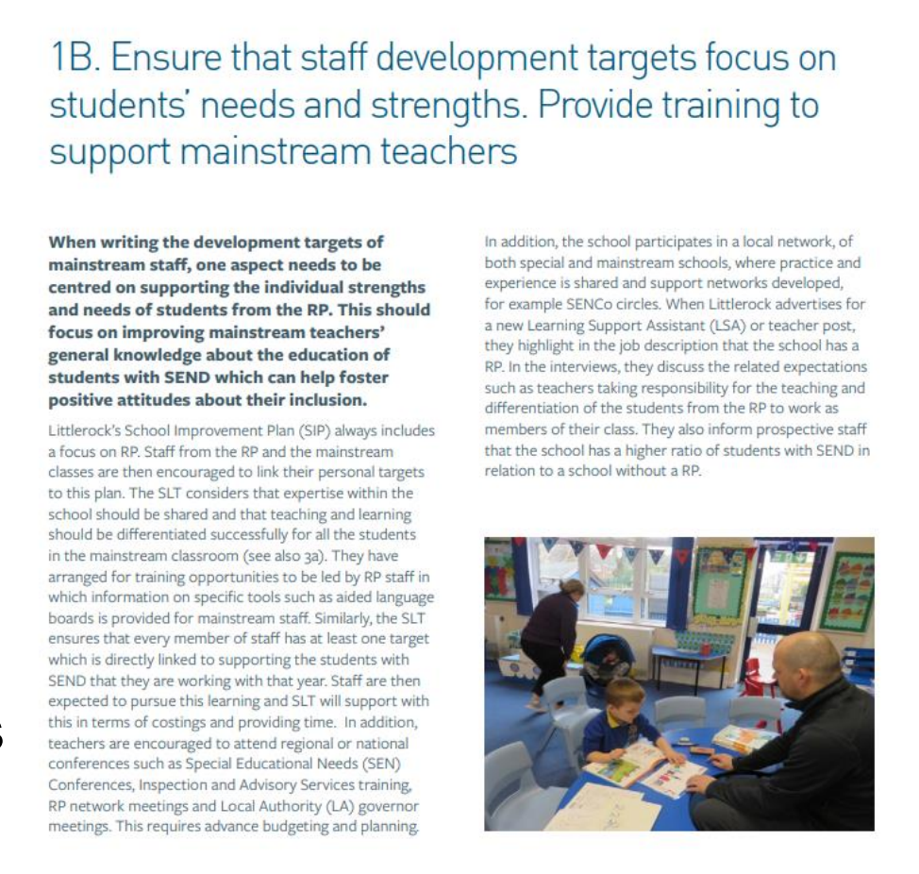
Staff Development
Training opportunities led by RP staff – aided language boards (ALB), visuals and Makaton.
SLT ensures EVERY staff member has one target linked to supporting pupils with special educational needs and disabilities (SEND).
Networks for both mainstream and special.

Slide 8
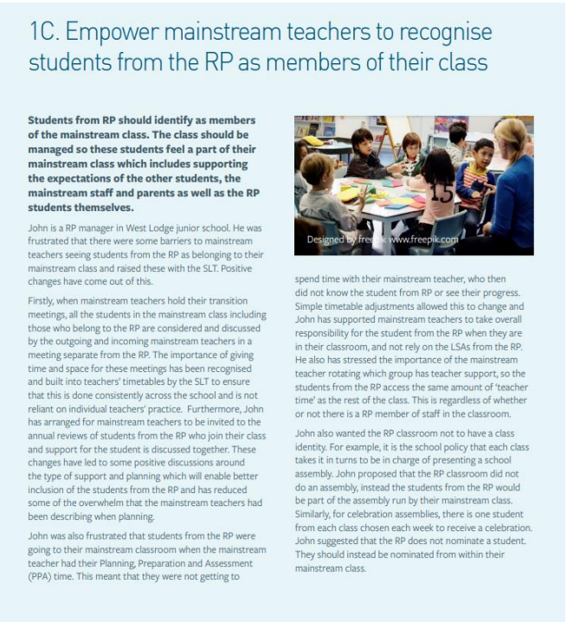
Empowering staff
When holding their transition meetings, all students in the mainstream class including those who belong to the RP are considered and discussed by the outgoing and incoming mainstream teachers in a meeting separate from the RP.
Mainstream teachers invited to join the annual review meetings, everyone given the same message.
Ensure it is not a cover teacher when pupils visit the RP, mainstream teacher need to build the relationship with the pupil! It is ALL about relationships.

Slide 9
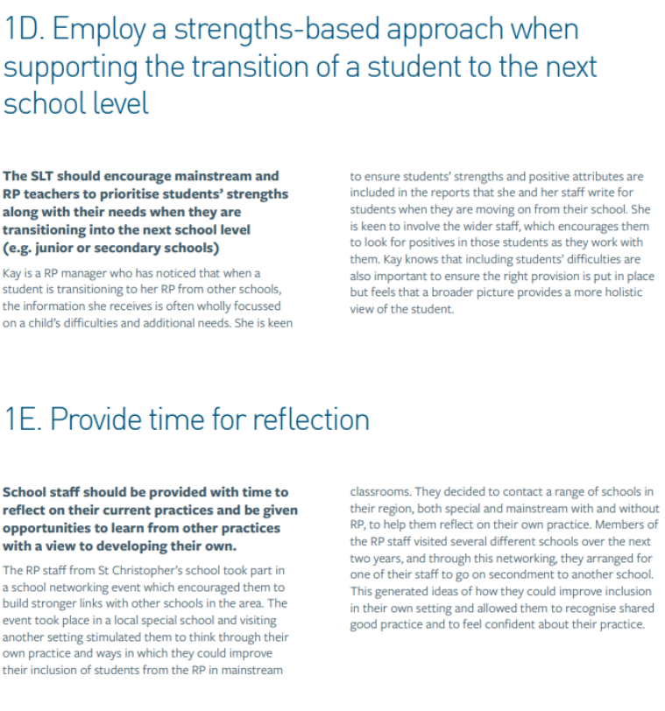
Strength based and time for reflection
People focus on the negative and not what pupils can do and their strengths. Focusing on this gives us a broader picture and provides a more holistic view of the student.
One RP contacted a range of schools in their region, both special and mainstream with and without RP, to help them reflect on their own practice.

Slide 10
CAMHS support for parents and carers
Parent and carer support CAMHS.

Slide 11
Parent advice line

Slide 12
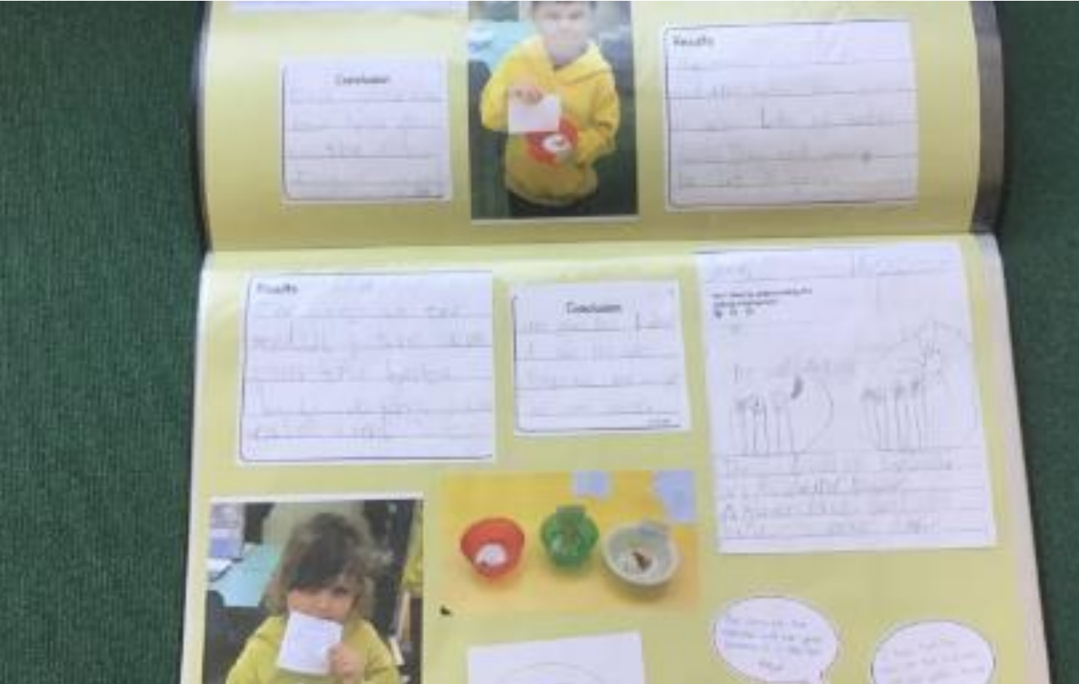
Sharing professional expertise Floor books by Gemma Waldron

Slide 13
Updates and free training
Online Inclusive Education Course – FutureLearn
Two, one-hour sessions covering
What is inclusive education?
Concepts that underpin inclusion
Inclusive education in context
Complex needs Training materials for teacher of learners with severe, profound and complex learning difficulties (complexneeds.org.uk)
3 modules Free online learning modules/ addressing dyslexia
Free online sensory processing course for teacher, assistants and parents (griffinot.com)

Slide 14
National updates
SN07020.pdf
Participating Local Authorities –DBV in SEND
Hampshire are part of delivering better value

Slide 15
Ofsted updates
GOV.UK (www.gov.uk) A one stop shop page for all Ofsted updates
Ofstednews – YouTube for videos and webinars
16 September 2024: Ofsted handbook updated for 2024
Key changes include
You won’t get an overall effectiveness grade in graded inspections anymore.
There are changes to how to work out the likely date of your next inspection.
Ungraded inspections will focus on whether schools have taken effective action to maintain the standards identified at the previous inspection and won't include deep dives.
Inspections will be suspended for 3 months, to allow leaders to improve safeguarding.
For more details, see our Summary of changes - GOV.UK as well as our more detailed summary of Ofsted changes for the 2024/25 academic year: summary | GovernorHub

Slide 16
Ofsted updates
Removal of one-word judgements
Inspections will receive a grade for each of the main judgement areas - quality of education, behaviour, and attitudes, personal development and leadership and management.
Schools with EYFS and Sixth Form with also receive a grade for this aspect
Schools notified from 9.30 am on a Monday with inspection starting the following day – rather than waiting until Wednesday
Ofsted have introduced a team to support well being concerns, new guidance, including where they have concerns about the well being of a leader or staff member. Pausing the inspection

Slide 17
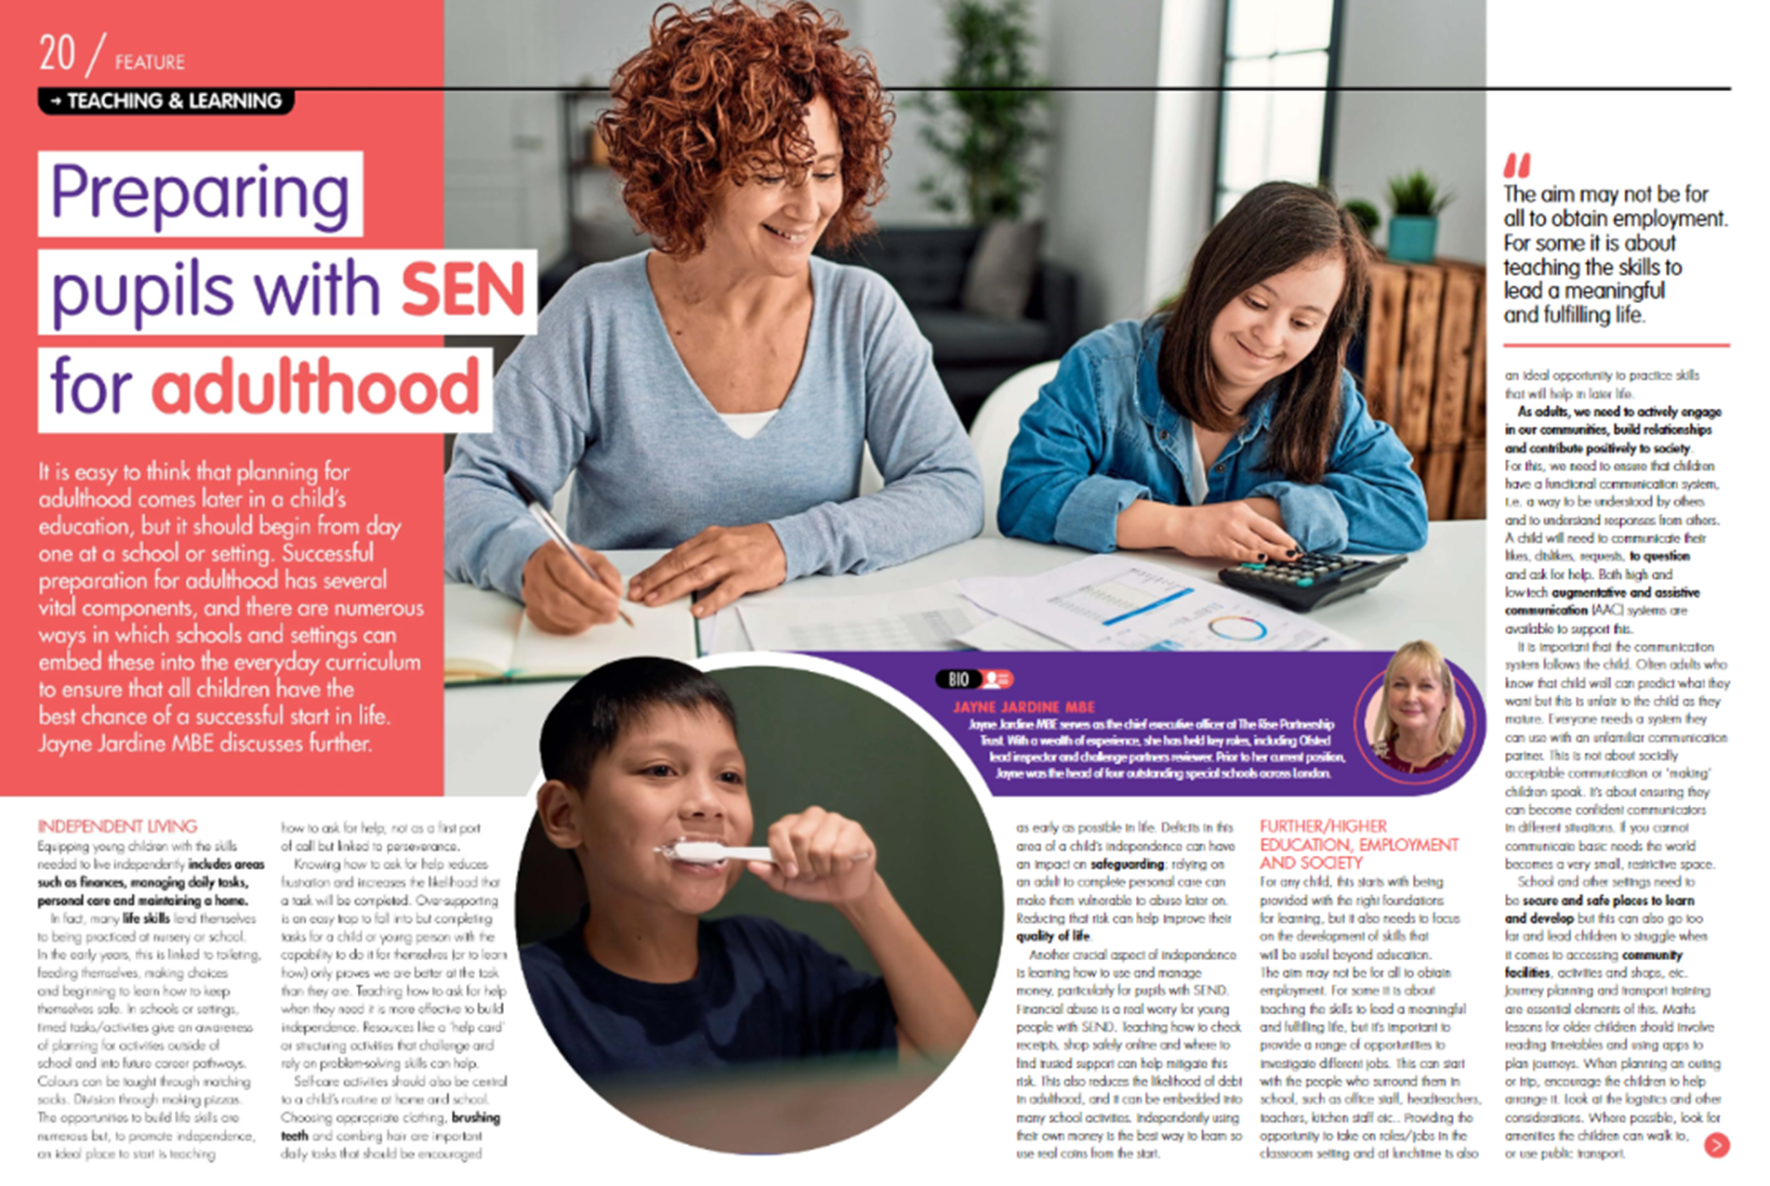
National association for special educational needs (NASEN)
News listing | Nasen

Slide 18
NASEN Resources
The Nasen Connect magazine – these are available free of charge and contain a range of articles and resources.
nasen Connect magazine Autumn Term edition 2024 | Nasen
CPD – Nasen offers CPD on a wide range of topics and themes ranging from universal to high quality practice and condition specific introductions.
Events listing | Nasen
CPD is available along with blogs, webinars and podcasts – need to register for access
SecEd - Home (sec-ed.co.uk)

Slide 19
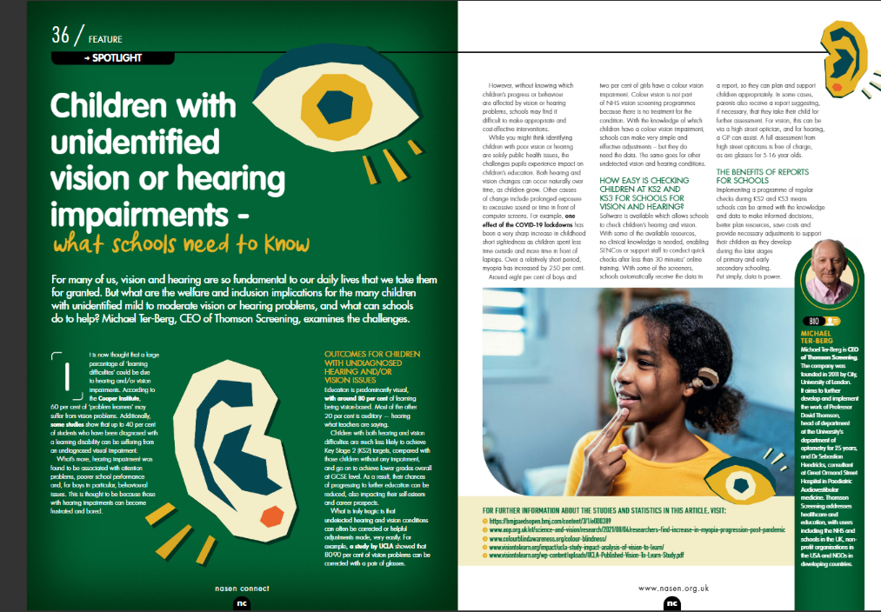

Slide 20
NASEN CPD programme offer
Events listing | Nasen

Slide 21
SEN Support Toolkit, SEN Support Line & SEN Advisers
A SEN Support Toolkit, offering online resources and signposting to advice, guidance and best practice information in supporting pupils with SEN needs. The focus is on the graduated approach which underpins practice for all children with SEN and as such this toolkit may be useful for all colleagues supporting children with SEN needs.
Access to the online SEN Support Toolkit is free and unhindered by paywalls or passwords. Simply select the link
Course: Hampshire SEN Support Toolkit
A SEN Support Line, offering tailored email or telephone / Teams' responses from highly qualified SEN professionals about specific challenges or concerns practitioners in school may still need support with after liaison with colleagues including their SENCo, and having accessed the SEN Support toolkit.
Please save the SEN Support Line enquiry form link to your favourites. If you don’t want to use them immediately it will help make it easy to find them when you do want them! https://forms.office.com/e/mrX19kBP82
Three new SEN Advisers, who will operator our new SEN Support phone line and manage our new SEN Support Toolkit.
They can be commissioned by school to support teachers in the classroom, using the 'plan, do, review' approach to better meet the needs of children and young people in the classroom(s).
The SEN Advisers can also be commissioned to provide support, guidance and problem solving with teachers and SENCo's on classroom-based support.
They join our already established team of Special Educational Needs Inspectors and are all available to support our schools.

Slide 22
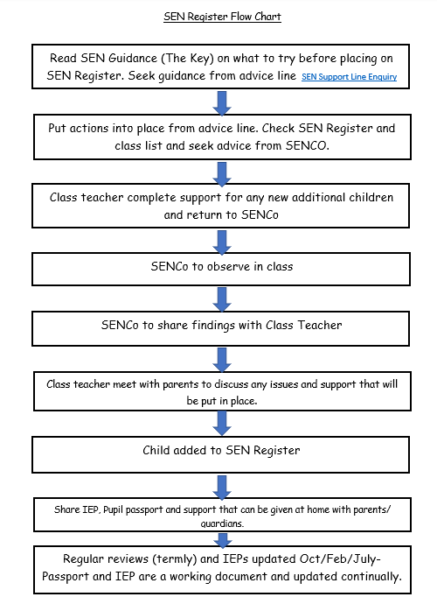
SEN Flow chart

Slide 23
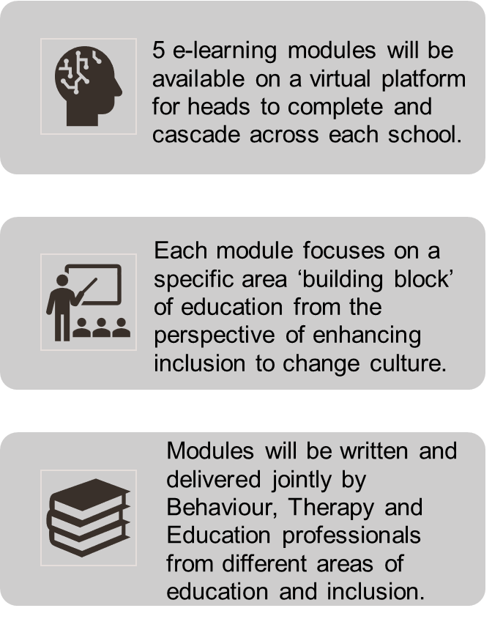
A reminder, 5 training Modules
Module 1
Neurodevelopmental approaches to learning
Module 3
Inclusive curriculums and the four pillars of an inclusive curriculum
Module 5
Relationships, behaviour and attendance, taking a neurodiversity affirming approach
Module 2
Module 4
Inclusive teaching and strategies that will extend and support
Inclusive learning environments
SEN Moodle: All courses (hants.gov.uk)
Centrally Funded

Slide 24
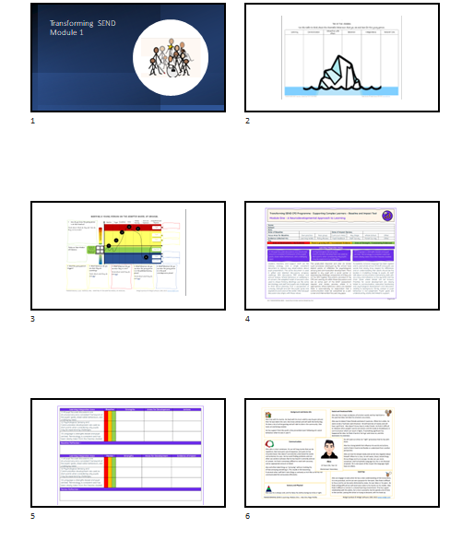
Slides for module one

Slide 25
Future Meetings
Role of the HT and Senior Leadership Team including governors
Useful to have an RP governor if possible or ensure that the SEN governor is aware of the RP
Role of the RP manager as a leader of teaching and learning
Role of TAs within RP and in lessons (some only focus on the pupil they are with)
Sharing good practice – providing an inspiring and appropriate curriculum within the RP and enabling the CYP to access the wider school curriculum
Tracking pupil progress and sharing this with other staff who work with the CYP
Assessment of specific needs (VI/HI/etc and how these impact on learning and development)
Self-Evaluation of RP, areas for improvement – link to SIP
Staff Training – keeping up to date with current practice
Specialist equipment to support access to learning
Outreach/Inreach
Support for parents
Working as part of a multidisciplinary team
Meetings structure
Would you like to visit other settings?
Two virtual, one face to face
All face to face
One virtual, two face to face
Duration
One hour or one and a half ?
Training
Executive Functioning skills
Parent workshops
Phonics
AAC support
STAS input
Clicker
Makaton
Colourful sematics

Slide 26
Next network meetings
10 March 2025 from 4pm to 5.30pm
24 June 2025 from 4pm to 5.30pm
Chaired by Marie Mullins and input from Michelle Habgood and Sarah Easley

