Slide 1
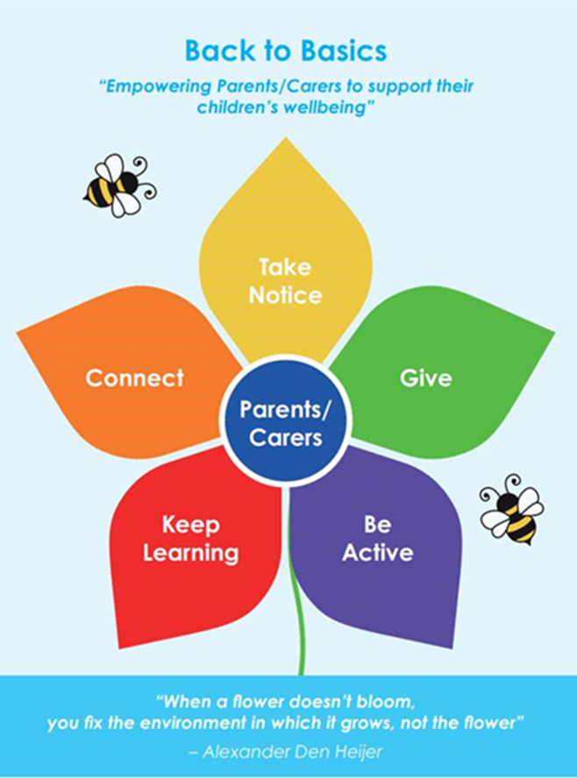
Back to Basics Campaign
Shelly Aldridge – Project Officer
Shelly.Aldridge@hants.gov.uk

Slide 2






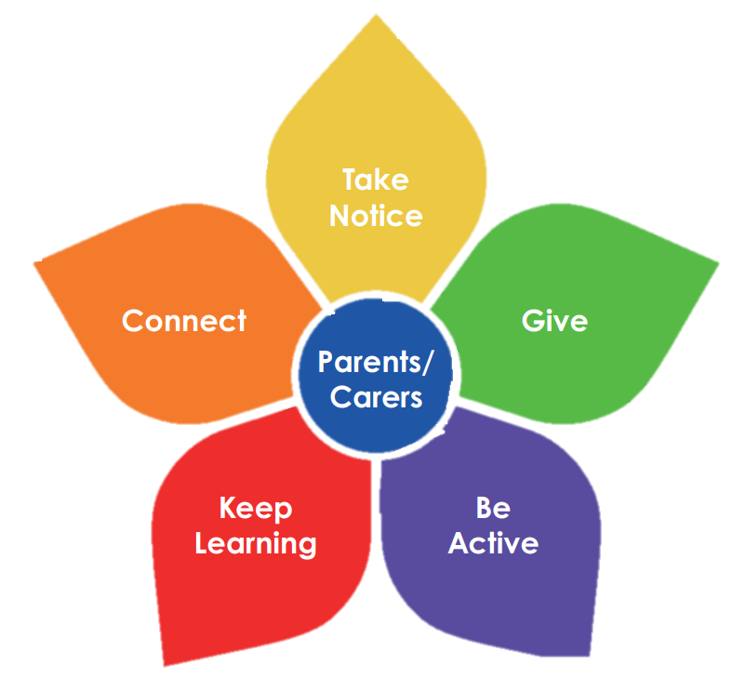
Back to Basics
Helping you look after your own wellbeing
Back to Basics
“Empowering Parents/Carers to support their children’s wellbeing”
What is Back to Basics?
A Community Campaign
to support the 5 Ways of Wellbeing
Five ways to Wellbeing | Health and social care | Hampshire County Council (hants.gov.uk)
Overall purpose of the project:
To support Families to manage their wellbeing by creating resilience and empowerment for families to manage their wellbeing within the home.
Impact
Empower Families to manage wellbeing within the home and to feel better equipped thus reducing the waiting list times for those who require speciality services.
“When a flower doesn’t bloom, you fix the environment in which it grows, not the flower” – Alexander Den Heijer

Slide 3


Back to Basics Online Platform
Back to Basics
Helping you look after your own wellbeing
https://www.hants.gov.uk/socialcareandhealth/childrenandfamilies/back-to-basics
“When a flower doesn’t bloom, you fix the environment in which it grows, not the flower” – Alexander Den Heijer

Slide 4

Back to Basics
“Empowering Parents/Carers to support their children’s wellbeing”
Back to Basics Video’s
The 5 ways of wellbeing
Off the Record have Produced videos to support Back to Basics – this is a great direct work tool to go through with families, young people or even to go on websites and social media:
https://www.youtube.com/results?search_query=off+the+record+back+to+basics
“When a flower doesn’t bloom, you fix the environment in which it grows, not the flower” – Alexander Den Heijer

Slide 5
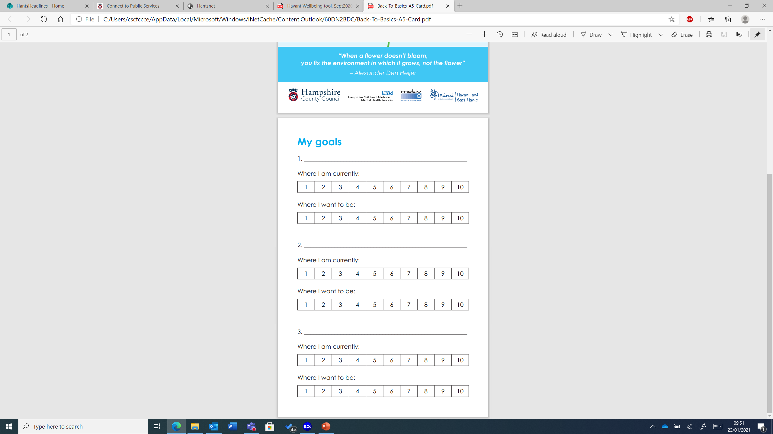
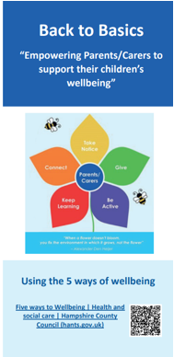
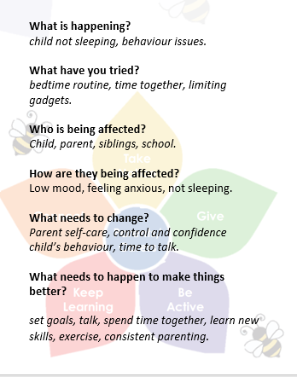
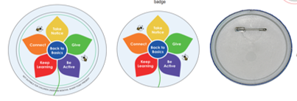
Resources
“When a flower doesn’t bloom, you fix the environment in which it grows, not the flower” – Alexander Den Heijer

Slide 6
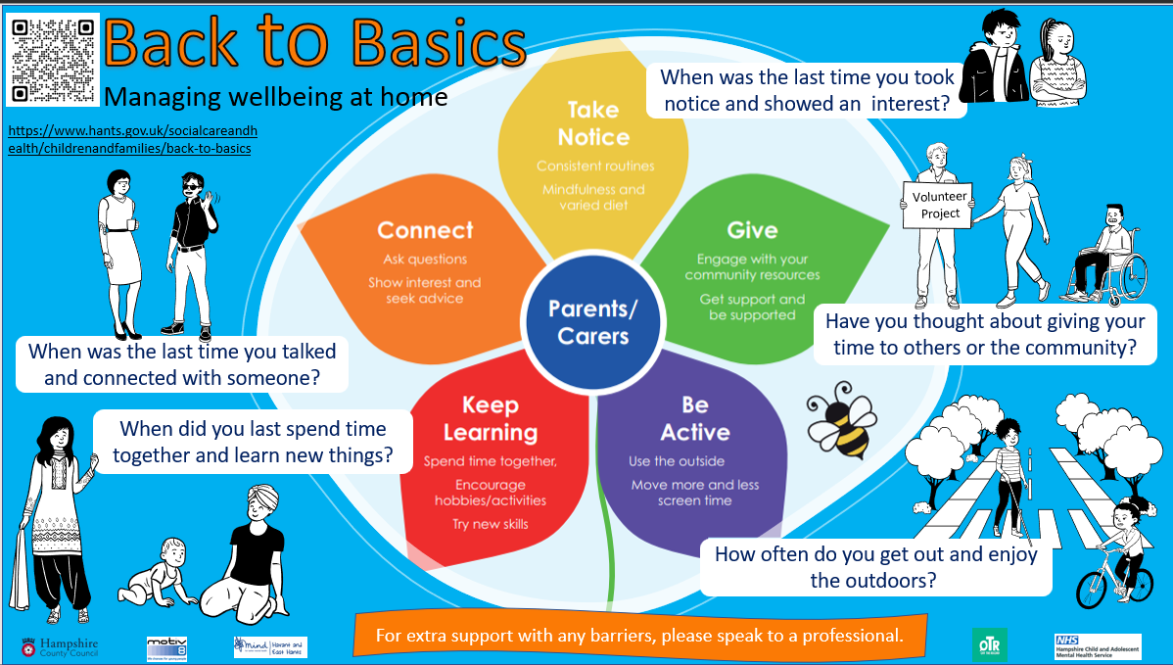

Slide 7
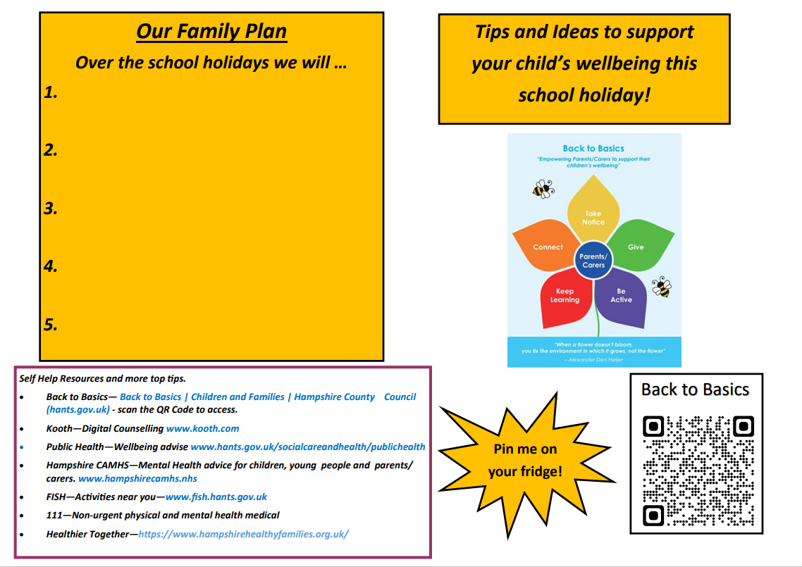
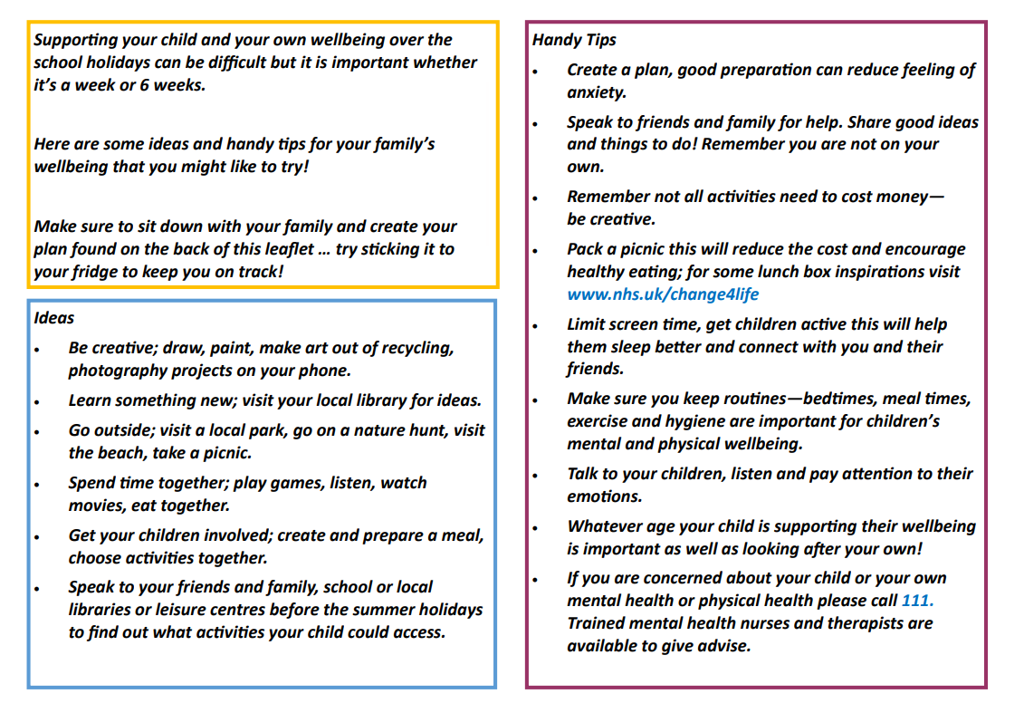
Back to Basics
Helping you look after your own wellbeing
“When a flower doesn’t bloom, you fix the environment in which it grows, not the flower” – Alexander Den Heijer

Slide 8



Reporting Framework:
Questionnaire Form https://forms.office.com/Pages/ResponsePage.aspx?id=tdiBPwfuF0yGnB20OQGNm5eYG_U2mTVJoRItNKo4iSdUNzg0NzlTWVY4OFozM1pCM1lVUDJJVUNWSiQlQCN0PWcu
Case Study
https://forms.office.com/Pages/ResponsePage.aspx?id=tdiBPwfuF0yGnB20OQGNm5eYG_U2mTVJoRItNKo4iSdURVJUOFhMUkdCWkc1WkNOSFJFS09KT0NLSCQlQCN0PWcu
Goal Setting Cards
https://forms.office.com/Pages/ResponsePage.aspx?id=tdiBPwfuF0yGnB20OQGNm5eYG_U2mTVJoRItNKo4iSdURVRDWE43VUs4Rk9EWDdFSUI4MDg2Wk5ZRCQlQCN0PWcu
“When a flower doesn’t bloom, you fix the environment in which it grows, not the flower” – Alexander Den Heijer

